Slide 1
Action Items For Accountability 2015
URGENT and INTENSE

Slide 2
To receive a Met Standard or Met Alternative Standard rating, all campuses and districts must meet the following targets on all indexes for which they have performance results in 2014.
2014 Accountability Targets [non-AEA Districts and Campuses]
 | Index 1 | Index 2 | Index 3 | Index 4
 |  |  |  | All 4 components | STAAR only
District | 55 | 16 | 28 | 57 | 13
Campus:
Elementary | 55 | 33 | 28 | N/A | 12
Middle School |  | 28 | 27 | N/A | 13
High School/K-12 |  | N/A | 31 | 57 | 21
2014 Accountability Manual Appendix L

Slide 3
Subject |  | Phase 1 | Phase 2 | Final | Level III
Reading | Grade 3 | 53% | 65% | 75% | 88%
 | Grade 4 | 52% | 66% | 77% | 86%
 | Grade 5 | 54% | 65% | 76% | 87%
 | Grade 6 | 52% | 65% | 75% | 88%
 | Grade 7 | 52% | 64% | 74% | 84%
 | Grade 8 | 50% | 63% | 75% | 85%
 | English I | 53% | 60% | 63% | 85%
 | English II | 54% | 59% | 63% | 85%
Math | Grade 3 | 59% | 72% | 83% | 91%
 | Grade 4 | 60% | 71% | 81% | 90%
 | Grade 5 | 54% | 66% | 78% | 88%
 | Grade 6 | 42% | 58% | 71% | 87%
 | Grade 7 | 44% | 56% | 69% | 85%
 | Grade 8 | 39% | 52% | 64% | 88%
 | Algebra 1 | 37% | 50% | 61% | 83%
Science | Grade 5 | 59% | 70% | 80% | 91%
 | Grade 8 | 56% | 65% | 74% | 78%
 | Biology | 37% | 51% | 61% | 83%
Social Studies | Grade 8 | 50% | 62% | 73% | 83%
 | US History | 41% | 53% | 65% | 81%
Writing | Grade 4 | 52% | 61% | 68% | 84%
 | Grade 7 | 54% | 63% | 71% | 85%
Index 1 2014
Index 3 2014
Index 1 2015
Index 3 2015
Index 4 2014
Index 4 2015
Index 3 2014
Index 3 2015
Notes:
59

Slide 4
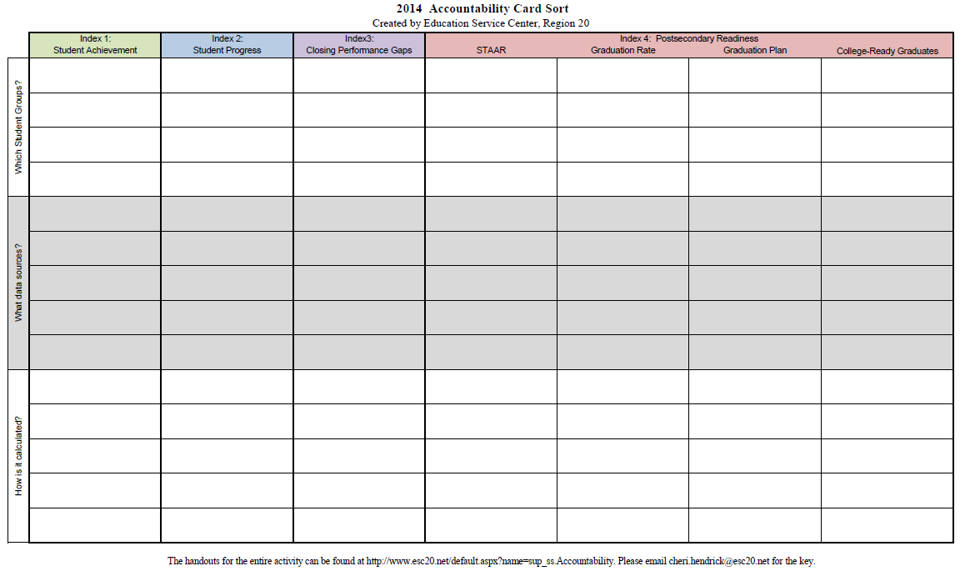
2014 Accountability Card Sort

Slide 5
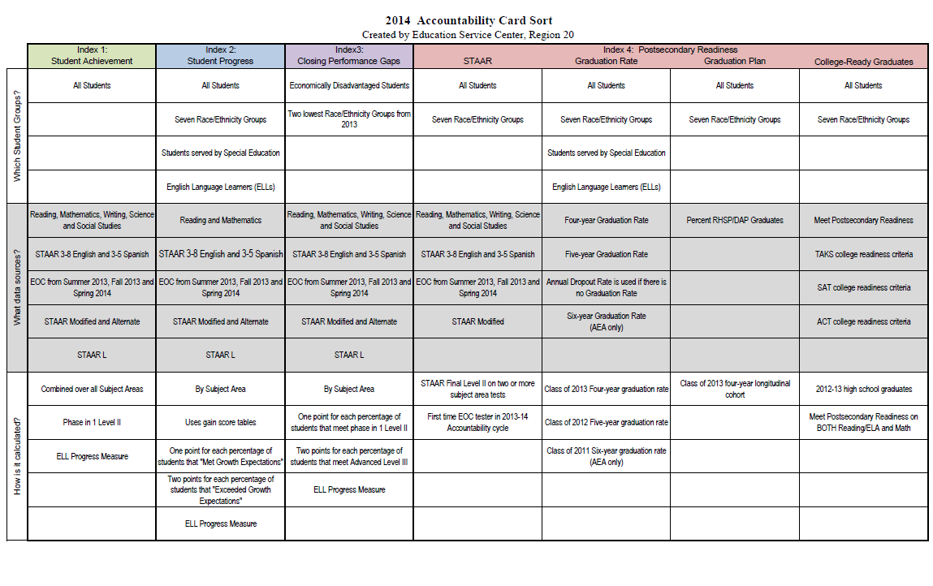
2014 Accountability Card Sort
Index 4

Slide 6
Drivers
High end performance, not mere passing at low standards. Level III performance is just as important as “passing”, whatever that may be.
Special emphasis economically disadvantaged students and Level II performance.
Growth, you can “pass” and still fail in Index 2.
Final Recommended Standard is the goal. Phase-in is not extremely important in an Index system.

Slide 7
Action Item # 1:
Changing the Questions The Teachers Ask When They Get Data!
How many Level III students do we have?
How many Level II students are just below Level III?
Are students making progress to the Level II Final Recommended Standard?
How am I going to differentiate to ensure all students make progress?

Slide 8
Action Item #2:
Create Intervention/Enrichment for Level III students to keep them there!!
Level III is just as important as passing in this system.
Not maintaining Level III students in this system will negatively impact Index 1 and 3 and could lead to IR rating regardless of how many students “passed.”

Slide 9
Action Item #3:
Creating a climate where teachers “grind” everyday!
Student growth is an everyday, all day affair.
Gaps in instruction no matter how small or inconsequential they may seem can make or break students with little background knowledge.
Teacher attendance and attention to each child is paramount for Index 2 and ELL success.

